Slide 1
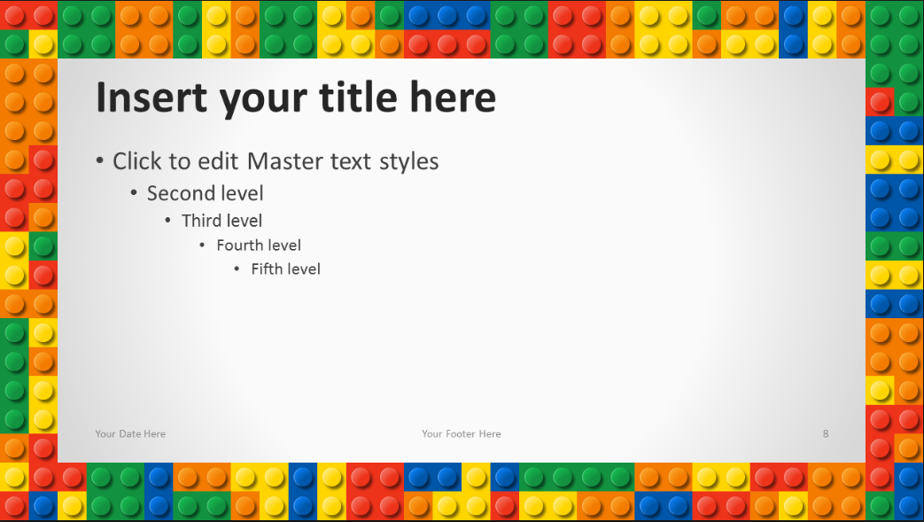
Once upon a time, there were two knights who were best friends and who lived in a forest. One day they heard that there was a beautiful princess locked in a high tower. The two knights decided to help each other and save the princess.
Situation Card 1

Slide 2
Situation Card 2
“What an adventure!” said Jenny as she carried her runaway kitten back home. Jenny had saved “Kitty” from the scary old house on the hill. People had said that an old witch lived there.
Jenny was brave enough to visit the scary house and save her kitten.

Slide 3
Situation Card 3
“Well, what are we going to do now?” asked Paula. “Here we are, stuck in the middle of the ocean with a crazy pirate who thinks he’s the King of Driftwood Island.”
“And we’re all tied up.” said Peter.
“But hey! Not all of us! Salty the dog is still free!” exclaimed Paula. “I have a great idea!”
What do you think Paula’s great idea is? What do you think will happen next?

Slide 4
Situation Card 4
For many children it is lots of fun sitting around a campfire. Out in the country the stars shine brightly and tiny creepy creatures run around in the darkness. Imagine that you are with friends on a camping trip, lighting a campfire for the very first time.

